Slide 1
Government Common & Model Apps
Packaging & Layering
Government Model Apps
Government Processes
Government Connection Roles
Government Common CDM
Microsoft Dataverse
Government Specific Solutions
Existing Microsoft Business Applications Solutions

Slide 2
Government Common CDM -> Primary Entities
Entity Name
Application
Housing Benefit Application
Business License Application
External System
Grant
Business Grant Application
License
Permit
Building Permit Application
Program
Program Benefit
Program Eligibility Requirement
Program Participant
Service
Government Model Apps
Government Processes
Government Connection Roles
Government Common CDM
CDM Common

Slide 3
Government Common CDM -> Primary Entities (continued)
Government Model Apps
Government Processes
Entity Name
Service Type
Service Recipient
Government Connection Roles
Government Common CDM
CDM Common

Slide 4
Government Common CDM -> Enriched Entities
Government Model Apps
PowerApps Portal
Dynamics 365 Higher Education Accelerator Common Canvas Model Apps
Dynamics 365 Higher Education Accelerator Common
Entity Name | Source
Account | CDM Common
Connection | CDM Common
Contact | CDM Common
Government Processes
Education Accelerator Connection Roles
Government Connection Roles
Education Accelerator Common Common
Government Common CDM
CDM Common
CDM Common

Slide 5
Government Connection Roles -> Primary Connection Roles
Connection Roles
Government Program
Government Service
Program Director
Program Manager
Program Coordinator
Service Manager
Service Deputy
Service Agent
Government Model Apps
Government Processes
Government Connection Roles
Government Common CDM
CDM Common

Slide 6
Government Processes -> Enriched Entities
Entity Name | Source
Application | Government Common CDM
Business License Application | Government Common CDM
Housing Benefit Application | Government Common CDM
Building Permit Application | Government Common CDM
Business Grant Application | Government Common CDM
Government Model Apps
Government Processes
Government Connection Roles
Government Common CDM
CDM Common

Slide 7
Government Model Apps -> Enriched Entities
Entity Name | Source
Application | Government Common CDM
Program Participant | Government Common CDM
Service Recipient | Government Common CDM
Government Model Apps
Government Processes
Government Connection Roles
Government Common CDM
CDM Common

Slide 8
Government Model Apps -> Apps
App Name | Type
Government Services | Model-Driven
Government Model Apps
Government Processes
Government Connection Roles
Government Common CDM
CDM Common

Slide 9
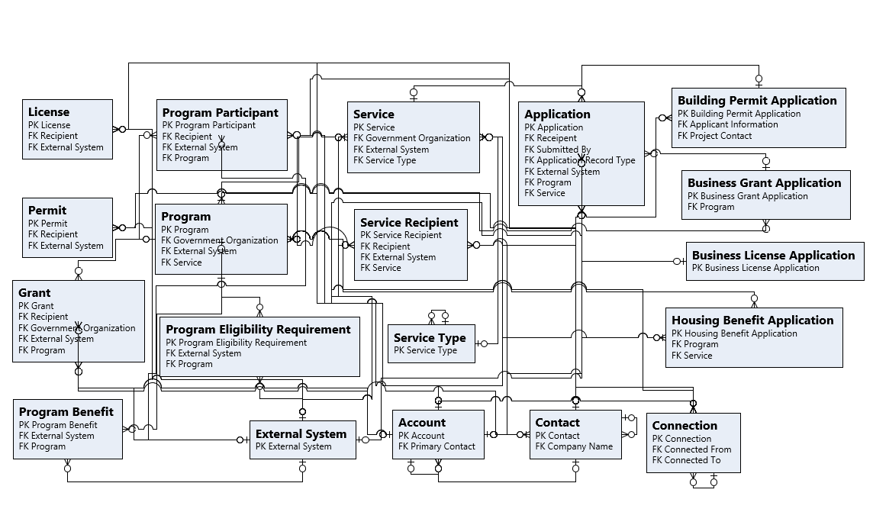
ERD : Government Common

